Slide 1

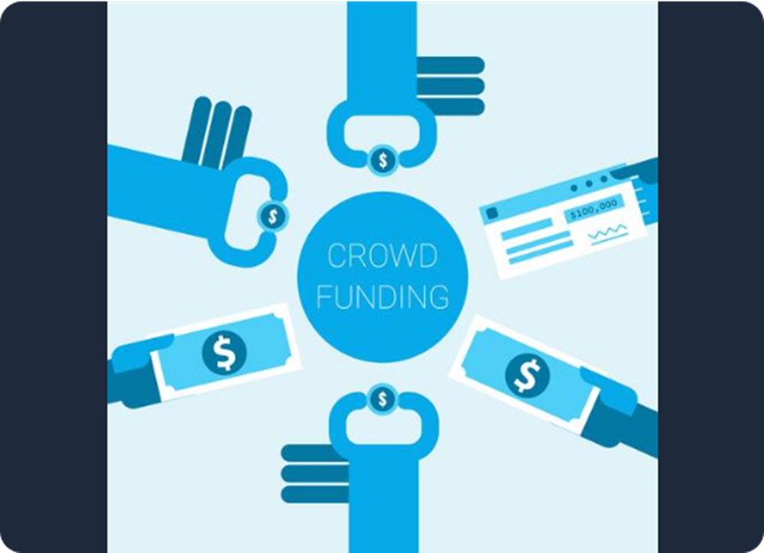
Crowdfunding Project Performance Analysis
Data-Driven Insights Across Multi-Platform Dashboards
Presented By : Group 1
Karan
Aditya
Subham
HemaSree
Sneha
Mounika
Janhvi

Slide 2
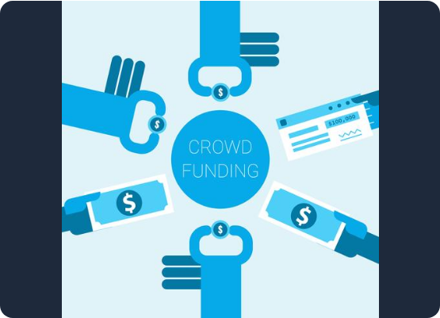

Crowdfunding Project Performance Analysis
Understanding Crowdfunding
Crowdfunding is a method of raising capital through the collective effort of friends, family, customers, and individual investors.
This approach taps into the collective efforts of a large pool of individuals—primarily online via social media and crowdfunding platforms—and leverages their networks for greater reach and exposure.

Slide 3









Core Performance Metrics
3,65,892
1,40,313
38.35%
80.43
TOTAL PROJECTS
SUCCESSFUL PROJECTS
SUCCESS RATE
AVG. DAYS (SUCCESS)

Slide 4
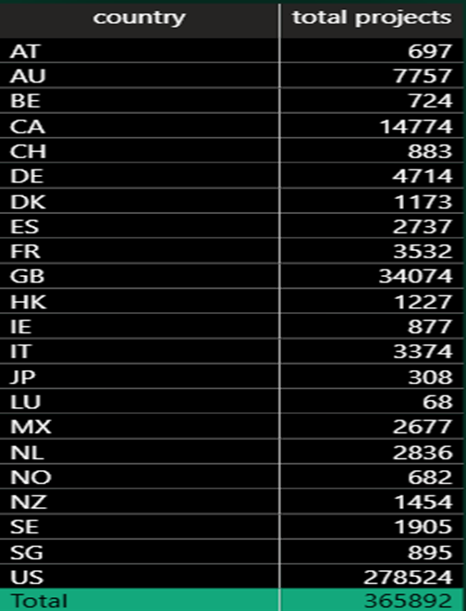
Core Performance Metrics
3,65,892
TOTAL PROJECTS
1,40,313
38.35%
80.43
SUCCESSFUL PROJECTS
SUCCESS RATE
AVG. DAYS (SUCCESS)

Slide 5
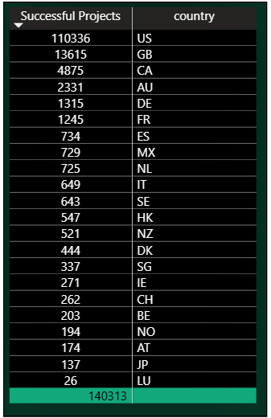
Core Performance Metrics
1,40,313
SUCCESSFUL PROJECTS
3,65,892
38.35%
80.43
TOTAL PROJECTS
SUCCESS RATE
AVG. DAYS (SUCCESS)

Slide 6
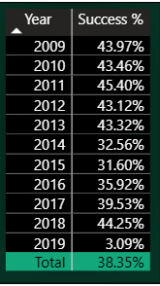
Core Performance Metrics
38.35%
SUCCESS RATE
3,65,892
1,40,313
80.43
TOTAL PROJECTS
SUCCESSFUL PROJECTS
AVG. DAYS (SUCCESS)

Slide 7
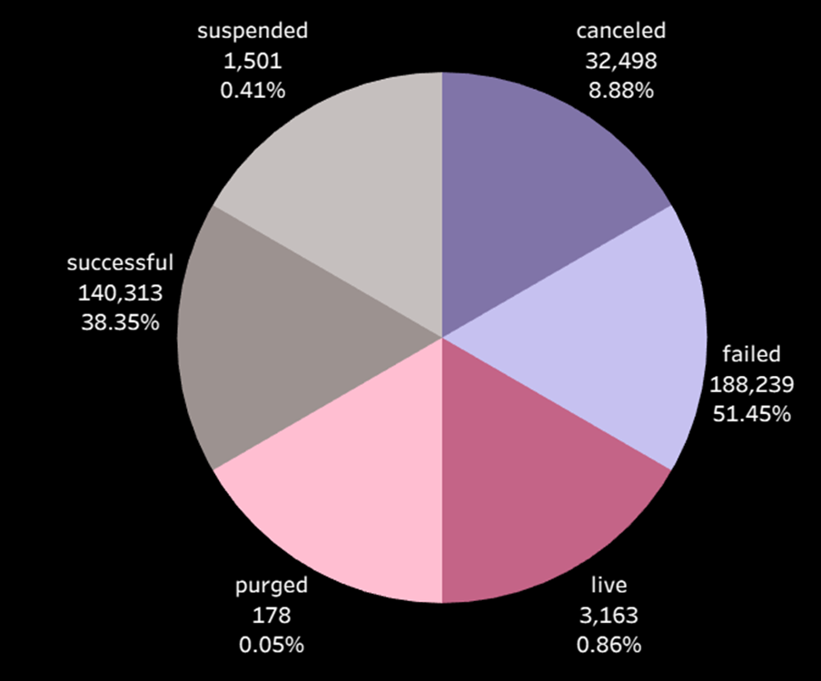
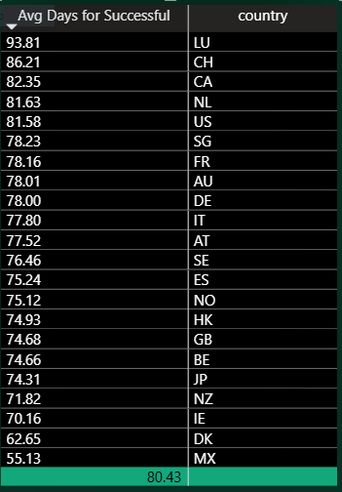
Core Performance Metrics
80.43
AVG. DAYS (SUCCESS)
3,65,892
1,40,313
38.35%
TOTAL PROJECTS
SUCCESSFUL PROJECTS
SUCCESS RATE

Slide 8


Distributions of Outcomes
Core Performance Metrics
Successful
Failed
Live
3,65,892
Cancelled
1,40,313
Suspended
38.35%
Purged
80.43

Slide 9
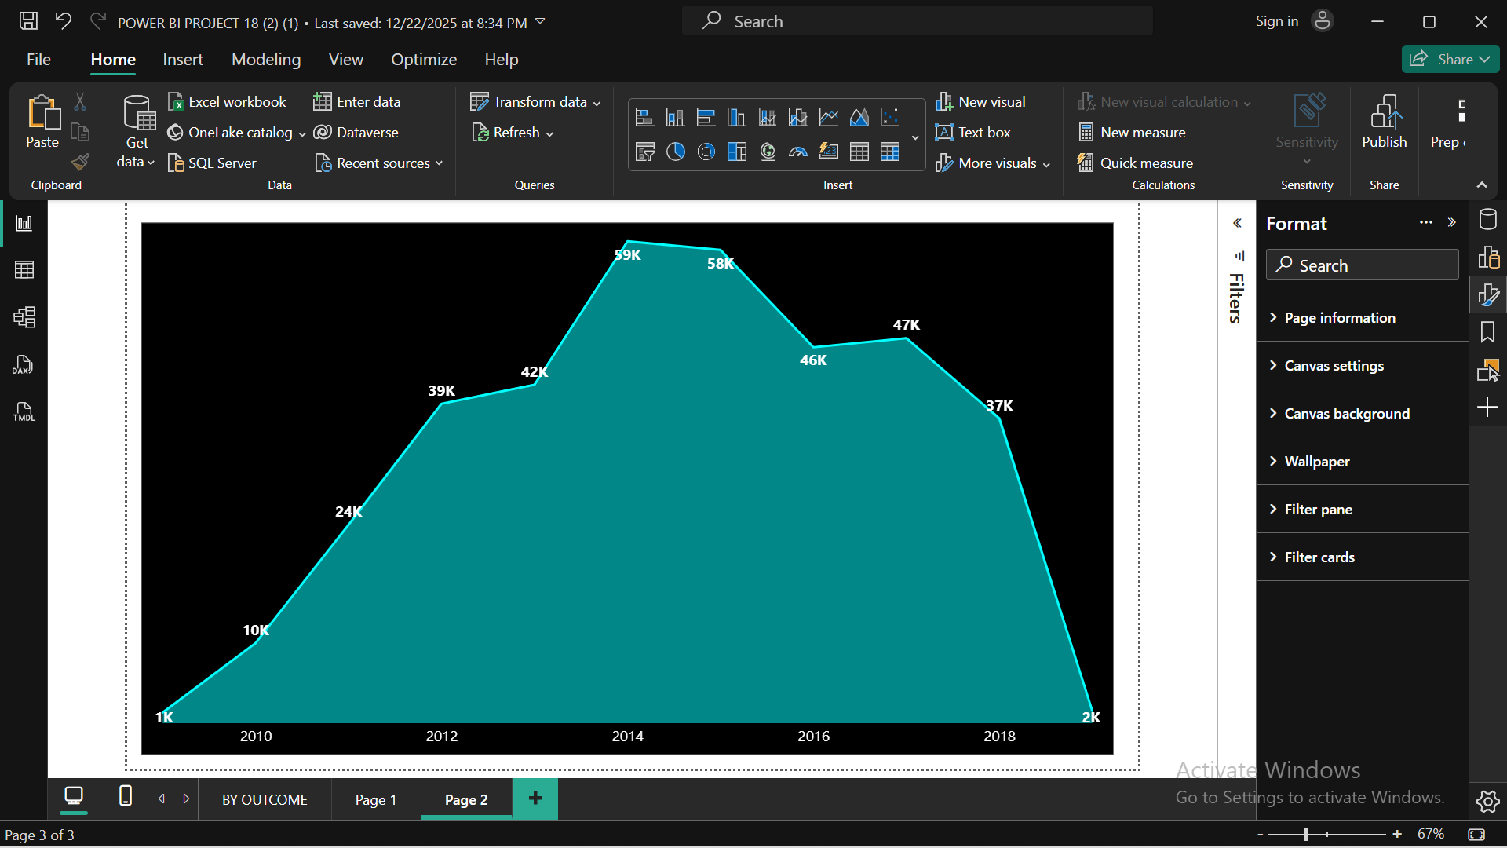
Market Growth Over Time
Core Performance Metrics
Distributions of Outcomes
Successful
Failed
Live
3,65,892
Cancelled
1,40,313
Suspended
38.35%
Purged
80.43
Insight: The number of projects grew quickly from 2009 and reached a high of 59,000 in 2014. After that peak, the totals began to drop, showing a very sharp decrease by 2019.

Slide 10
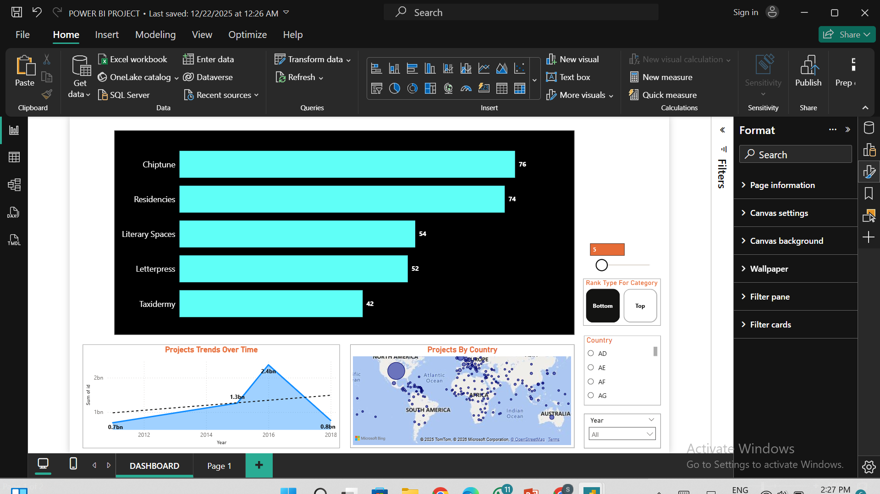
Success Rate By Category
Core Performance Metrics
Distributions of Outcomes
Market Growth Over Time
Successful
Failed
3,65,892
Live
1,40,313
Cancelled
Suspended
Insight: The number of projects grew quickly from 2009 and reached a high of 59,000 in 2014. After that peak, the totals began to drop, showing a very sharp decrease by 2019.
38.35%
80.43
Purged
Insight: Chiptune and Residencies are the most popular niche categories with the highest success rate. Taxidermy has the lowest number of projects in this group, with a total % of 42.

Slide 11

Geographic Distribution ( Top 5 )
Location | Projects Launched | Successful Project
Los Angeles, CA | 18,596 | 8,237
New York, NY | 14,150 | 7,155
London, UK | 11,468 | 4,848
San Francisco, CA | 6,236 | 3,394
Brooklyn, NY | 5,624 | 3,548

Slide 12
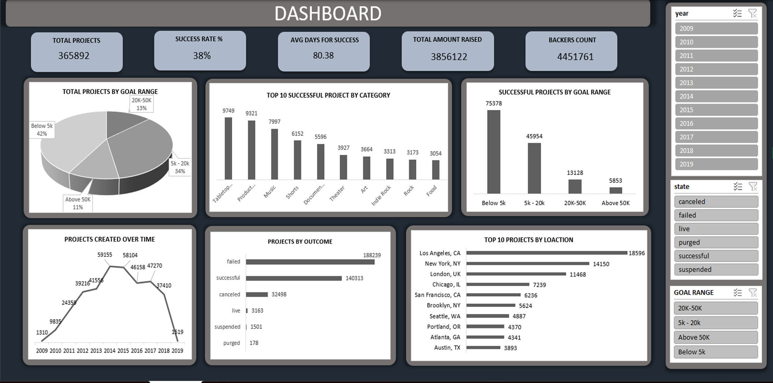
Location | Projects Launched | Successful Project
Los Angeles, CA | 18,596 | 8,237
New York, NY | 14,150 | 7,155
London, UK | 11,468 | 4,848
San Francisco, CA | 6,236 | 3,394
Brooklyn, NY | 5,624 | 3,548
Excel: Core Analytics
A simple way to track daily project updates and funding goals using Excel’s easy pivot tables and automated reports.

Slide 13
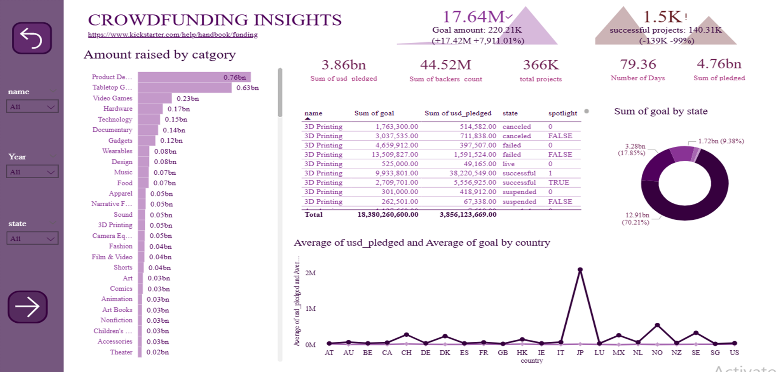
Location | Projects Launched | Successful Project
Los Angeles, CA | 18,596 | 8,237
New York, NY | 14,150 | 7,155
London, UK | 11,468 | 4,848
San Francisco, CA | 6,236 | 3,394
Brooklyn, NY | 5,624 | 3,548
Power BI: Interactive Insights
A clear look at global crowdfunding totals and project funding goals using Power BI's simple layouts and interactive data charts.

Slide 14
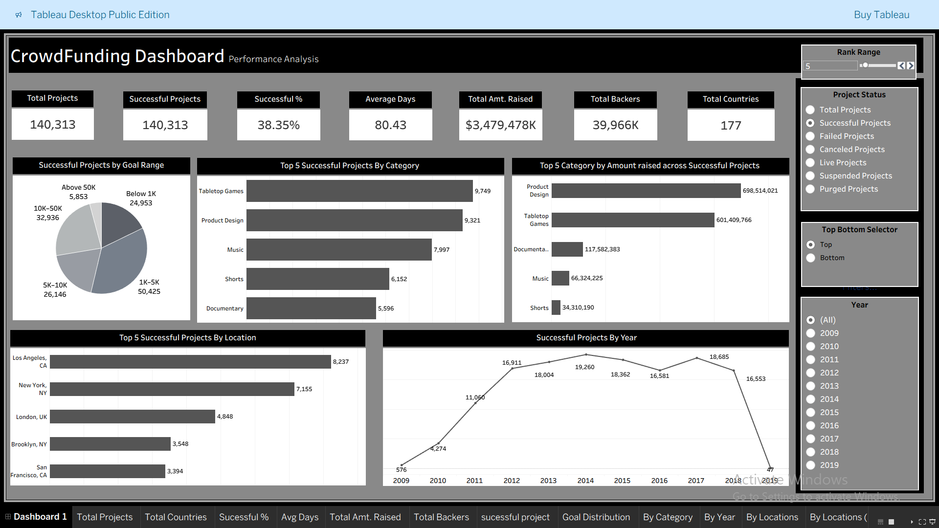
Location | Projects Launched | Successful Project
Los Angeles, CA | 18,596 | 8,237
New York, NY | 14,150 | 7,155
London, UK | 11,468 | 4,848
San Francisco, CA | 6,236 | 3,394
Brooklyn, NY | 5,624 | 3,548
Tableau: Visual Exploration
A clear look at crowdfunding trends and project success using Tableau's simple and interactive data charts.

Slide 15

Conclusions & Outlook
Conclusions & Outlook
Multi-platform analysis reveals that Games and Tech remain dominant, but funding velocity is highly dependent on community engagement. Integrated dashboards allow for predictive success modeling across all funding platforms.
Crowdfunding is a global success, raising billions of dollars from millions of backers for hundreds of thousands of projects.
Product Design and Tabletop Games are consistently the top-performing categories, attracting the most interest and funding overall.
Integrated Dashboard allows us to see project trends change over time, the community's support for new ideas remains very strong across many countries.

Slide 16
Conclusions & Outlook
Multi-platform analysis reveals that Games and Tech remain dominant, but funding velocity is highly dependent on community engagement. Integrated dashboards allow for predictive success modeling across all funding platforms.
Thank you

